Slide 1


Database Management System (BCSC-0003)
Topic: Introduction to DBMS
Nikhil Govil
Assistant Professor, Dept. of CEA, GLA University, Mathura.

Slide 2

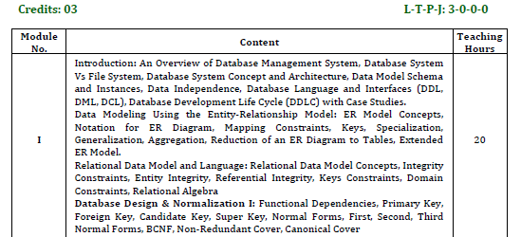
Syllabus

Slide 3
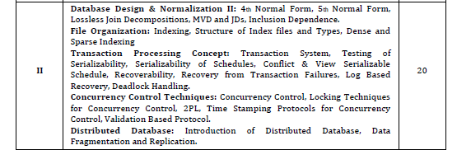
Syllabus

Slide 4
Suggested Books
Text Books:
Elmasri and Navathe, “Fundamentals of Database Systems”, 6th Edition, Addision Wesley, 2010.
Sadalage, P. & Flower, “NoSQL Distilled: A Brief Guide to the Emerging World of Polyglot Presistence”, Pearson Education, 2012.
Reference Books:
Date C J,” An Introduction to Database Systems”, 8th Edition, Addision Wesley.
Korth, Silbertz and Sudarshan, “Database Concepts”, 5th Edition, TMH, 1998.
Redmond, E. & Wilson, “Seven Databases in Seven Weeks: A Guide to Modern Databases and the NoSQL Movement”, 1st Edition.

Slide 5
Database Management System (DBMS)
A Database Management System (DBMS) is a software designed to store, retrieve, define, and manage data in a database.
‍DBMS software primarily functions as an interface between the end user and the database, simultaneously managing the data, and the database schema in order to facilitate the organization and manipulation of data.
A database management system functions through the use of system commands, first receiving instructions, then instructing the system accordingly, either to retrieve data, modify data, or load existing data from the system.

Slide 6
Difference Between Data & Information in DBMS
Data is raw, unprocessed, unorganized facts that are seemingly random and do not yet carry any significance or meaning.
Information refers to data that has been organized, interpreted, and contextualized by a human or machine so that it possess relevance and purpose.
Information is filtered data that has been made systematic and useful, and is considered to be more reliable and valuable to researchers as proper analysis and refinement has been conducted.

Slide 7
File System Vs DBMS
File System:
The file system is basically a way of arranging the files in a storage medium like a hard disk.
The file system organizes the files and helps in the retrieval of files when they are required.
File systems consist of different files which are grouped into directories.
The directories further contain other folders and files.
The file system performs basic operations like management, file naming, giving access rules, etc.

Slide 8
File System Vs DBMS
DBMS:
Database Management System is basically software that manages the collection of related data.
It is used for storing data and retrieving the data effectively when it is needed.
It also provides proper security measures for protecting the data from unauthorized access.
In Database Management System the data can be fetched by queries and relational algebra.
It also provides mechanisms for data recovery and data backup.

Slide 9
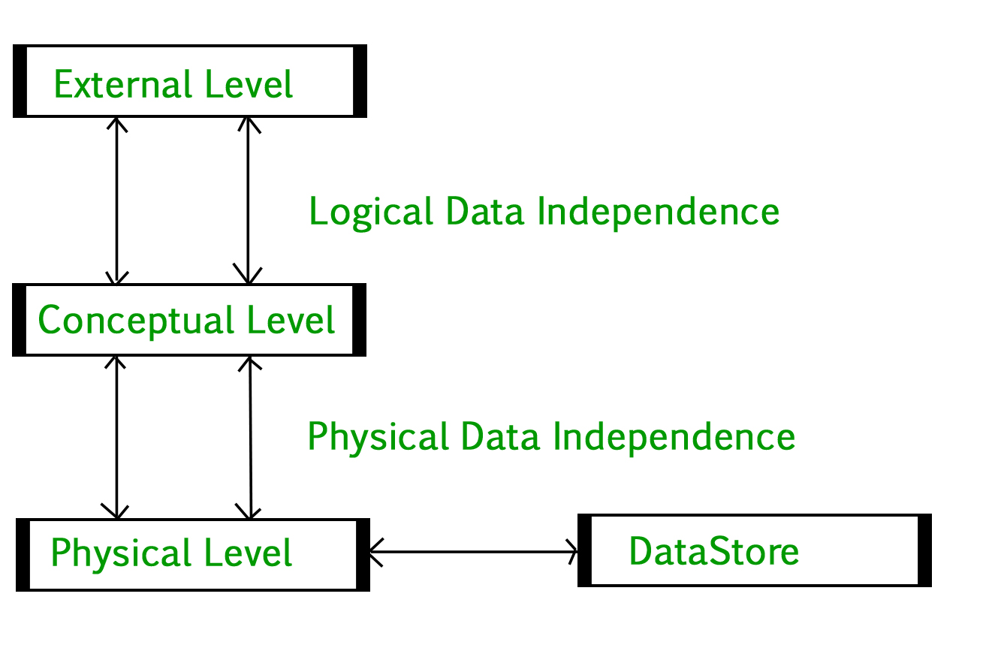
Introduction of 3-Tier Architecture in DBMS
DBMS 3-tier architecture divides the complete system into three inter-related but independent modules as shown below:

Slide 10
Introduction of 3-Tier Architecture in DBMS
Physical Level:
At the physical level, the information about the location of database objects in the data store is kept.
Various users of DBMS are unaware of the locations of these objects.
In simple term, physical level of a database describes how the data is being stored in secondary storage devices like disks and tapes.

Slide 11
Introduction of 3-Tier Architecture in DBMS
Conceptual Level:
At conceptual level, data is represented in the form of various database tables.
For Example, STUDENT database may contain STUDENT and COURSE tables which will be visible to users but users are unaware of their storage.
Also referred as logical schema, it describes what kind of data is to be stored in the database.

Slide 12
Introduction of 3-Tier Architecture in DBMS
External Level:
An external level specifies a view of the data in terms of conceptual level tables.
Each external level view is used to cater to the needs of a particular category of users.
For Example, FACULTY of a university is interested in looking course details of students, STUDENTS are interested in looking at all details related to academics, accounts, courses and hostel details as well.
So, different views can be generated for different users.
The main focus of external level is data abstraction.

Slide 13
References
Korth, Silbertz and Sudarshan (1998), “Database Concepts”, 5th Edition, TMH.
Elmasri and Navathe (2010), “Fundamentals of Database Systems”, 6th Edition, Addision Wesley.
Date C J,” An Introduction to Database Systems”, 8th Edition, Addision Wesley.
M. Tamer Oezsu, Patrick Valduriez (2011). “Principles of Distributed Database Systems”, 2nd Edition, Prentice Hall.

Slide 14


